Slide 1
Insurance Needs of the JATCs
2023 ESAC Conference
Niagara Falls, NY
Sally Corbin, Segal Justin Patten, ULLICO

Slide 2
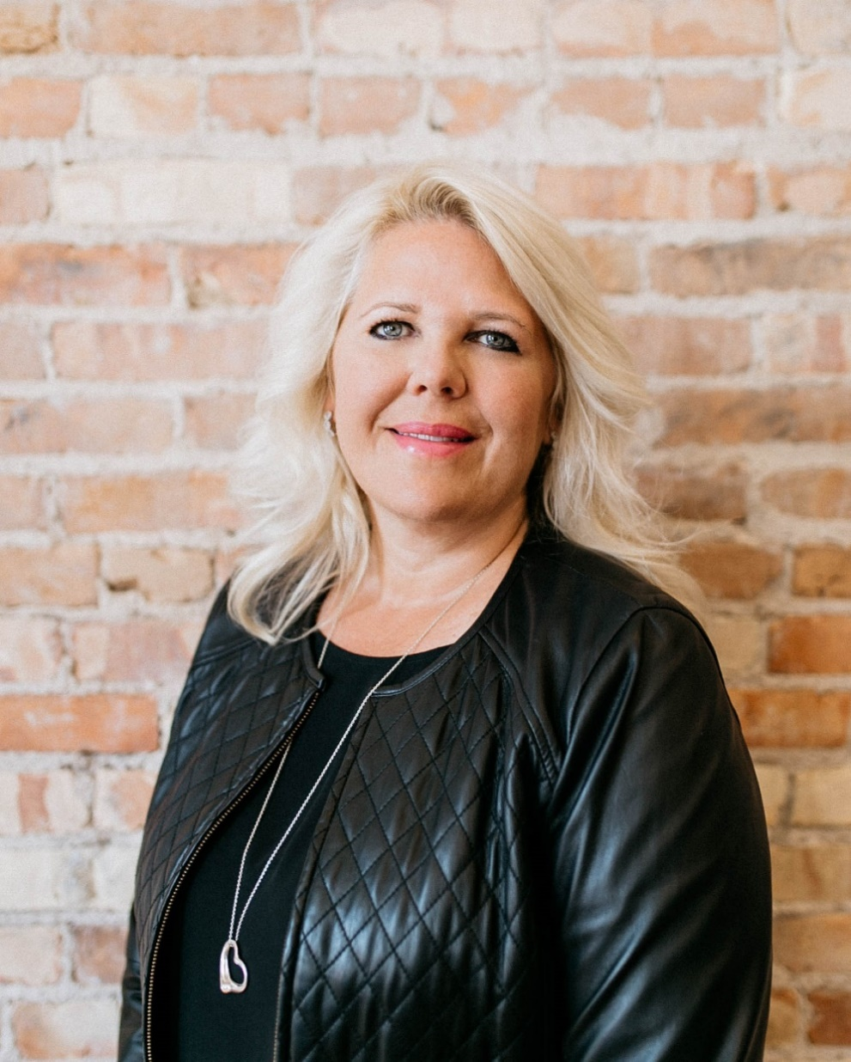
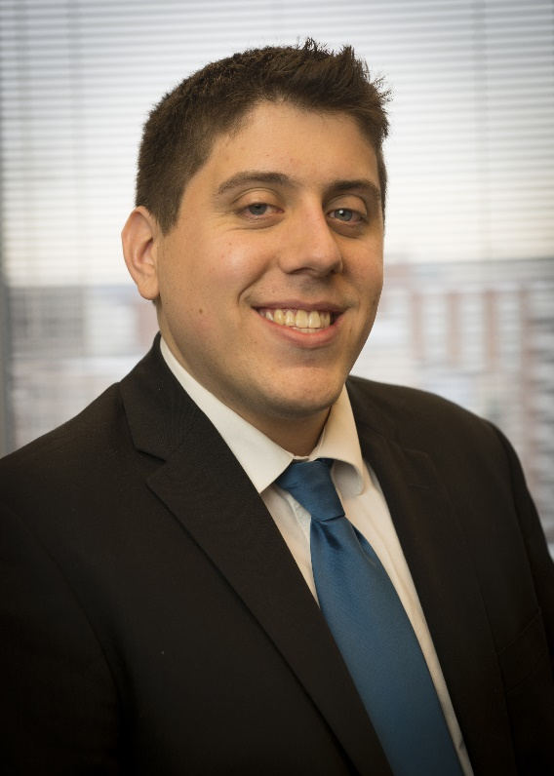
Today’s Presenters
Sally Corbin
Senior Vice President,
Director of Insurance Relations
Segal
scorbin@segalco.com
517.482.6700
Justin Patten
Director of Underwriting,
Professional Lines Ullico Casualty Group jpatten@ullico.com 202.682.4983

Slide 3
Why Can’t I Buy One Policy that Covers Everything?
Union Liability/
D&O
Workplace Violence
ERISA/ Fidelity Bonds
Commercial Insurance
Student Accident
Fiduciary Liability
Cyber Liability
Make sure you have an insurance broker who understands your risk!
Notes:
Commercial Liability – Property, Liability, Crime, Auto, Inland Marine, Umbrella
Union Liability/ D&O - Educators Liability, Employment Practices Liability, 3rd Party Discrimination & Harassment Liability, Personal Injury

Slide 4
Commercial Insurance What is covered?
Commercial Insurance
Property
Liability
Crime
Auto Liability
Inland Marine
Umbrella

Slide 5
Commercial Insurance
Commercial Insurance
Property insurance offers protection against loss or damage caused by fire, windstorm, hail, lightning, explosion, vandalism, riot or civil commotion or other causes of loss as described in the policy forms.
Liability Insurance affords protection to the Insured from claims alleging damages for bodily injury or property damage due to an accident or occurrence on owned or rented premises or claims that arise from union business operations.
Commercial crime coverage includes employee theft and regular theft.

Slide 6
Commercial Insurance
Commercial Insurance
Commercial auto protection insurance is available for vehicles owned by unions, pension and welfare funds, apprenticeship funds, covering both liability and physical damage.
Inland marine insurance generally provides broader protection against loss or damage to specific items than what is provided by commercial property insurance, could include special equipment, computers, machinery, valuable papers and more.
Umbrella insurance provides additional liability coverage.
Notes:
Most items that are mobile or temporarily in the custody of others can also be covered.

Slide 7
Tailored D&O Policy for JATCs Including Educator’s Liability
Union Liability/ D&O
Protects the training committee and leaders against claims common to operational exposures
Provides reimbursement for indemnity, defense, settlement and appeals from claims arising out of those risks

Slide 8
Union Liability for Training Funds What is covered?
Union Liability/ D&O
Error or Omission or Breach of Duty
Employment Practices including Third Party Discrimination (Apprentices, Journeymen, students)
EEOC, NLRB & similar charges are considered claims
Educators’ Liability – Professional E&O
Contingent BI
Personal Injury and Publishers Liability
Final, Non-Appealable Adjudication

Slide 9
Union Liability for Training Funds Who is covered?
Union Liability/ D&O
Fund, committees, designated subsidiaries/affiliates and individual insureds
Individual insureds include past, present and future directors, trustees, officers, employees, board members, volunteers, and committee members
Policy should include contracted instructors

Slide 10
Union Liability for Training Funds Claim examples
Union Liability/ D&O
Wrongful termination/discrimination
$235,000 defense/indemnity
Failure to educate (included bodily injury)
Ongoing and $120,000 in defense to date
Training fund’s admission procedure
$300,000 defense/indemnity
$2,300,000 requested by EEOC and settled for $320,000 defense/indemnity

Slide 11
Student Accident
Limited amount of coverage for injury to a volunteer or participant on a no-fault basis
Workers’ Compensation laws are complicated; provides a peace of mind
General Liability typically requires fault to be established
Student Accident

Slide 12
Workplace Violence
Employers have a certain level of responsibility to ensure the safety of employees as well as other visitors to the workplace.
In addition to policies, procedures and training, coverage should be obtained offering financial reimbursements to employees and visitors should an event occur.
Workplace Violence

Slide 13
Workplace Violence
Crisis management and public relations services
Mental health specialists
Independent forensic analysts
Victim employees’ salaries and replacement employees’ salaries
Medical, cosmetic, mental health and dental expenses of victims
Expenses related to dealing with a threats
Other related services and property protections
Workplace Violence

Slide 14
Fiduciary Liability
Trustees and other fiduciaries of multiemployer funds face significant personal liability in their daily duties due to responsibilities as imposed by the Employee Retirement Income Security Act (ERISA).
Fiduciary liability coverage is insurance that protects the Insured from the losses caused by claims that challenge the way a plan is administered, managed or operated.
Fiduciary Liability

Slide 15
Fiduciary Liability
Fiduciary Liability What is covered?
Investigatory/Pre-Claim/Interview Coverage
Fines, Penalties, and Taxes
502(a)3/Equitable Relief
Final, Non-Appealable Adjudication
Voluntary Compliance (VCP) reinstatement of limits
Waiver/Elimination of Recourse
Paid by the trustee, employer or the union (not the Fund)
Fiduciary Liability
Notes:
Fiduciary liability insurance is constantly evolving to keep up with new laws and outcomes under ERISA.
In a fiduciary liability policy, an insurance company agrees to reimburse a benefit fund or other claimant for losses caused by violations of ERISA fiduciary duties or errors by the fund's trustees or other fiduciaries.

Slide 16
Fiduciary Liability Who is covered?
Similar to union liability insurance, the scope of who is insured is broad and flexible.
Included is coverage for the plan, former and current trustees, employees, committees and any others designated by endorsement.
Fiduciary Liability

Slide 17
Fiduciary Liability JATC Claim examples
Prohibited transaction/expenses — $420,000 defense/indemnity
Plan assets for personal use — ongoing and $65,000 in defense to date/split with D&O policy
Delinquent Form 5500 exemption $1,3000
Fiduciary Liability

Slide 18
ERISA/Fidelity Bonds
Required to obtain in order to protect assets
Must be equal to 10% of assets; $500,000 Maximum Limit required (per occurrence)
Inflation Guard is recommended if the limit obtained is less than $500,000
No deductible for employee theft
Consider third party coverages
ERISA/ Fidelity Bonds

Slide 19
ERISA/Fidelity Bond Claim examples
Employee did not collect contributions and tried to cover up for the employer — $500,000 to plan
Trustee uses plan assets to stockpile his home with electronics from Best Buy — $500,000 to plan
Employee stole over $1,000,000 over 10 years through payroll — $500,000 to plan
ERISA/ Fidelity Bonds

Slide 20
Cyber Liability
JATCs, benefit trust funds and unions perform important duties by striving to provide the best benefits and conditions they can obtain for working men and women.
In carrying out these duties, trust funds and unions have access to the personal information of their participants and members.
If this data is lost, most states mandate response in a timely manner by notifying potentially affected individuals, regulators, and the press.
Cyber Liability
Notes:
Identify Risk, Mitigate Risk and Planning – Assessments (ERISA Advisory Council – November 2016)
Designing a policy that protects against cyber exposures
Depend on breach experts
Meeting legal obligations – Hitech, HIPPA, HHS
Risk transfer = Saving $
Not all policies are created equal

Slide 21
Cyber Liability Insurance
First Party
Investigate (legal & forensics)
Participant Notification (credit monitoring, identity theft, experts to meet state notification requirements)
Social Engineering (will not cover loss of assets unless endorsed to Cyber or Fidelity Bond)
Business Interruption (loss of net profit & extra expenses)
Data Protection
Third Party
Indemnity:
3rd Party Liability
Extortion/Ransomware
Regulatory Penalties
Media & Website content
Media Liability
Optional Coverages to consider:
Social Engineering for theft of assets
Coverage for telecommunication
Cyber Liability

Slide 22
Cyber Liability Insurance
Ransomware
What is Cybersecurity?
Phishing
Common Threats to Plan
Wire Transfer Email Fraud
Cyber Liability
Malware by External Devises

Slide 23
Why Do I Need to Care about Cybersecurity?
Avoid breaches of fiduciary duty!
Significant potential liability for funds
In April, 2022 the DOL provided no laws or regulation but guidance
Best practices for plan — protect your data
Hiring providers with strong cybersecurity practices
Select providers who will protect your data
Online security tips — avoid online scams
23

Slide 24
Cyber Liability More claim examples
Ransomware attack at a large pension fund caused the fund to be shut down for 2 weeks and had to replace hardware & software
Malware attack at a JATC caused the payroll person to believe she was logged onto bank website and paid $54,000 to an unknown bank account
Fund accidentally printed SSNs in the address label of marketing brochures that were sent to participants
Trustee left laptop on table at McDonald’s to refill coffee, laptop stolen by the time he returned to table
Cyber Liability

Slide 25
Several Cybersecurity Tools
DOL Guidance 2021
Best Practices: https://www.dol.gov/sites/dolgov/files/ebsa/key-topics/retirement-benefits/cybersecurity/best-practices.pdf
Hiring Providers with Strong Cybersecurity Practices: https://www.dol.gov/sites/dolgov/files/ebsa/key-topics/retirement-benefits/cybersecurity/tips-for-hiring-a-service-provider-with-strong-security-practices.pdf
Online Security Tips: https://www.dol.gov/sites/dolgov/files/ebsa/key-topics/retirement-benefits/cybersecurity/online-security-tips.pdf
How do I create a cybersecurity plan:
Check with insurance broker to see if carrier offers loss control tools
Review 2016 ERISA Advisory Council and 2021 Guidance and DOL guidance: https://www.dol.gov/sites/dolgov/files/ebsa/about-ebsa/about-us/erisa-advisory-council/2016-cybersecurity-considerations-for-benefit-plans.pdf
National Institute of Standards and Technology (NIST) Industry Standards:
www.nist.gov

Slide 26
Several Cybersecurity Tools
Additional cybersecurity policies (internally and vendors):
Employee access to data
Is access reviewed and audited
Internet/personal email usage
Social media
Passwords
Equipment disposal
Personal devices
Remote access
Encryption — when it should be used and steps to monitor use
Cybersecurity Training Topics to include:
End-User responsibility and discipline
Wifi access
Malware
Passwords
Social media
Web browsing
Review Incident Response Plan
Policies on removable media

Slide 27
Role of the Broker — Our Commitment
Ability to advocate for the insured
Experienced, educated, and insurance licensed support staff
Investment in the most updated technology
Certifications recognizing a commitment to modernization
Waiver of recourse
Individual labor leader endorsement
Professionalism, ethics and national reputation
Higher education level, including advanced degrees
Continued ERISA education
Ability to communicate with Fund’s legal counsel
Ability to meet with Trustees
Direct appointments and relationships with all major trustee fiduciary carriers
27
Notes:
Professionalism, Ethics, National Reputation
Education level including advanced degrees
ie. Juris Doctor (J.D.)
Commitment to furthering their education in the form of continued education in the ERISA arena
ie. International Foundation meetings, American Conference Institutes National forum on ERISA litigation as well as seminars sponsored by the major Trustee Fiduciary carriers in the U.S.
Commitment and ability to communicate with the Fund’s legal counsel regarding any endorsements attached to your Fiduciary Liability Policy and what restrictions they impose on coverage
Commitment and ability to meet with Trustees directly to discuss renewal terms and the merits and differences between major insurance carriers.
Ie. Some carriers have better reputations than others for paying claims, staying informed on the financial strength of insurance carriers and communicating with the Trustees when changes occur
Direct Appointments and Relationships with all of the major Trustee Fiduciary Insurance Carriers
Ability to advocate for the insured and to communicate effectively with the claims and underwriting departments
Experienced, Educated, and Insurance Licensed support staff
Understand the importance of the elimination of recourse provision
Understand how to properly invoice the trustees so this premium is not incorrectly paid out of plan assets
Agency Investment in the most updated technology to serve clients effectively and efficiently as well as interfacing with Insurance carriers.
Certifications that recognize the agency’s commitment to modernization and maximum effectiveness.
i.e. Total Quality Agency certification
Waiver of recourse
Individual labor leader endorsement

Slide 28
Questions?
Sally Corbin
Senior Vice President,
Director of Insurance Relations
Segal
scorbin@segalco.com
517.482.6700
Justin Patten
Director of Underwriting, Professional Lines Ullico Casualty jpatten@ullico.com 202.682.4983

